Slide 1
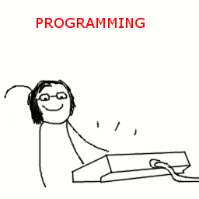
Group Programming Project 1
By: Robert Pearson and Tyler Doherty

Slide 2
Do You Struggle With Managing Your Money?

Slide 3


Slide 4

Well, We Have The Solution For You!

Slide 5


Budget Manager

Slide 6


What Can Our Budget Manager Do?
User can input their yearly salary
User can log monthly expenses into specific categories
User can view their expenses
Creates a monthly budget based off their salary

Slide 7
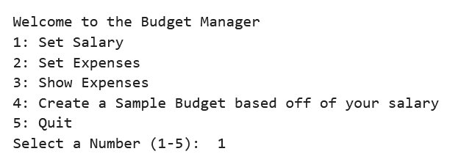

The Menu

Slide 8
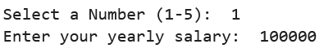

Salary
Step 1: Input yearly salary

Slide 9
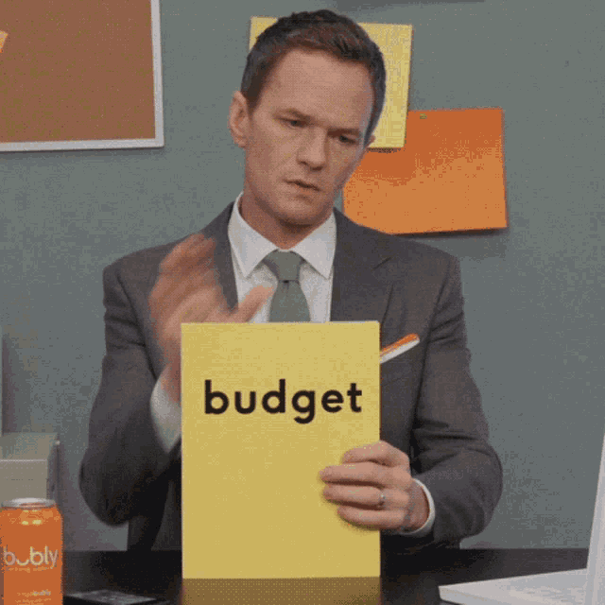
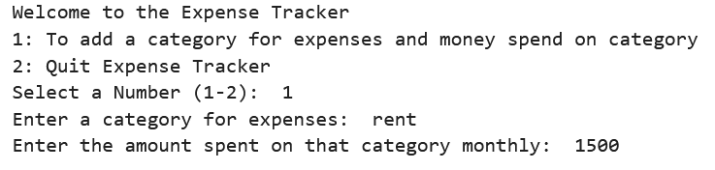
Setting Expenses
User can input their monthly expenses
They input the category first then how much they spent
Step 2: Input Monthly Expenses

Slide 10
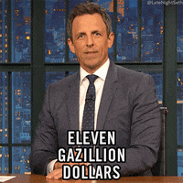
Showing Expenses
Displays monthly income and total monthly expenses
Displays the categories from their monthly expenses
Step 3: Displays your monthly budget

Slide 11

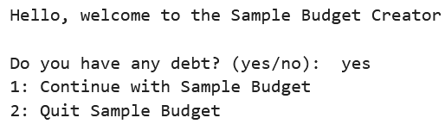
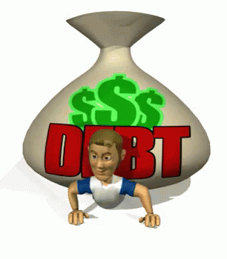
Creating Sample Budget
Based on users' monthly salary
Asks user if they have any debt because that will affect the budget creation
Step 4: Creates a monthly sample budget for you

Slide 12

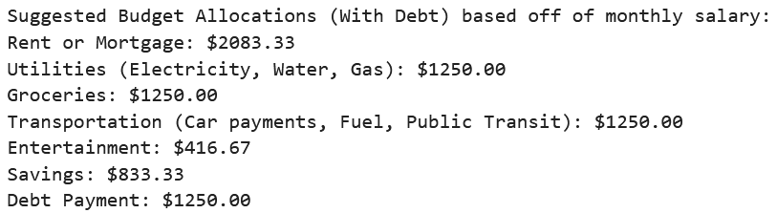
This will create a monthly budget for you to go by!

Slide 13

What Did We Learn?

Slide 14

About the process of budgeting

Slide 15

How important is to save

Slide 16
What Could We Improve?
Allow user to set their own categories for the budget
Make the process of adding expenses less tedious

Slide 17

The End

Slide 18

What will our budget manager do?
Input salary
Log monthly expenses
Set budget goals
View expenses
Inform user if expenses do not align with budget and salary

Slide 19

Building Blocks
dictionary
Lists
User Input
Functions
If Statements
While Loop
For Loop
Classes

